Slide 2
XML Schema
In this first lesson, XML Schema, you will learn to:
  Define and describe what is meant by schema.
  Identify the need for schema.
  Compare and differentiate the features of DTDs and schemas.
2

Slide 3
Schema 1-3
Is originated from a Greek word symbolizing form or shape.
Is a diagrammatic representation; an outline or a model.
Is only in the reach of the philosophers till it entered the zone of computer science.
Is generally understood to be a model used to describe the structure of a database.
Defines internal structures such as tables, fields, and the relationship between them.
Is a set of rules to constrain the structure and articulate the information set of XML documents.
Describes a model for a whole class of documents.
Defines the valid building blocks of an XML document.

Slide 4
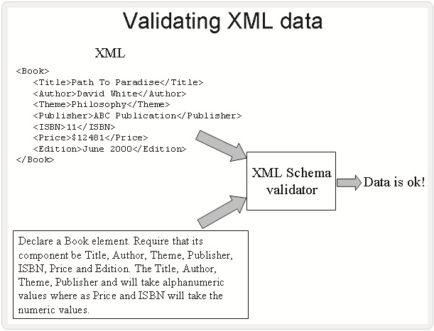
Schema 2-3
Figure depicts the XML data validation.

Slide 5
Schema 3-3
Code Snippet demonstrates an entity Book.
where,
  Compare the attributes of this 'BOOK', with the attributes of a book in general.
Snippet
<Book>
<Title>Path To Paradise</Title>
<Author>David White</Author>
<Theme>Philosophy</Theme>
<Publisher>ABC Publication</Publisher>
<ISBN>11</ISBN>
<Price>$12481</Price>
<Edition>June 2000</Edition>
</Book>

Slide 6
Definition of XML Schema 1-2
An XML Schema defines:
  Elements and attributes that can appear in a document.
  Elements that are child elements.
  Order and number of child elements.
  Element is empty or can include text.
  Data types for elements and attributes.
  Default and fixed values for elements and attributes.
Basic features are:
  XML syntax is used as the basis for creating XML schema documents.
  XML schemas can be manipulated just like any other XML document.

Slide 7
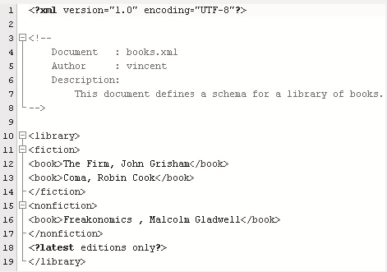
Definition of XML Schema 2-2
Figure depicts an XML Schema.

Slide 8
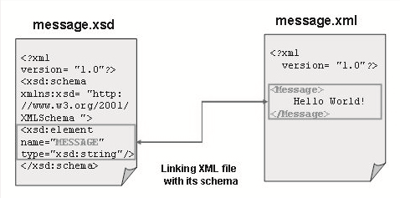
Writing an XML Schema 1-2
To explore Schema you need two files:
XML File
XSD File
Figure depicts XSD file.
Given XML document contains a single element, <Message>. A schema for this document has to declare the <Message> element.
For storing schema documents, the file is saved with ".xsd" as the extension. Schema documents are XML documents and can have DTDs, DOCTYPE declarations.
8

Slide 9
Writing an XML Schema 2-2
Code Snippet demonstrates the properties of XML Schema.
XML File: message.xml
XSD File: message.xsd
Snippet
<?xml version= "1.0"?>
<Message>
Hello World!
</Message>
Snippet
<?xml version= "1.0"?>
<xsd:schema xmlns:xsd= "http://www.w3.org/2001/XMLSchema ">
<xsd:element name= "MESSAGE " type= "xsd:string "/>
</xsd:schema>

Slide 10
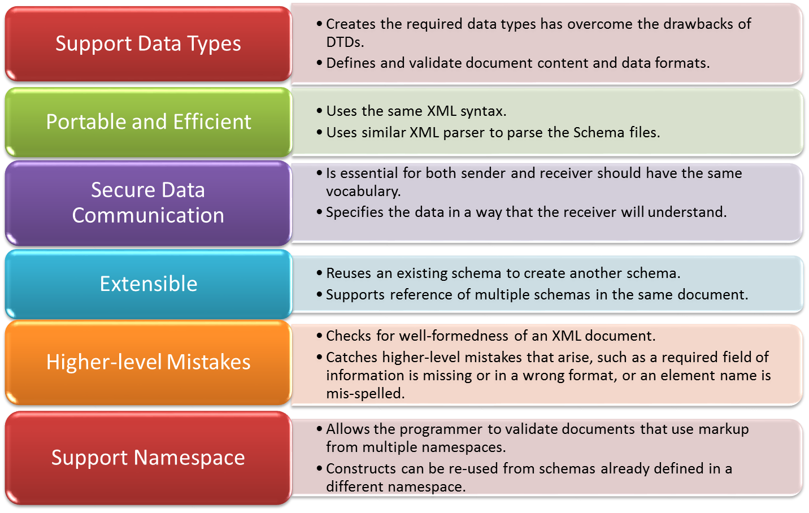
Features of Schema

Slide 11
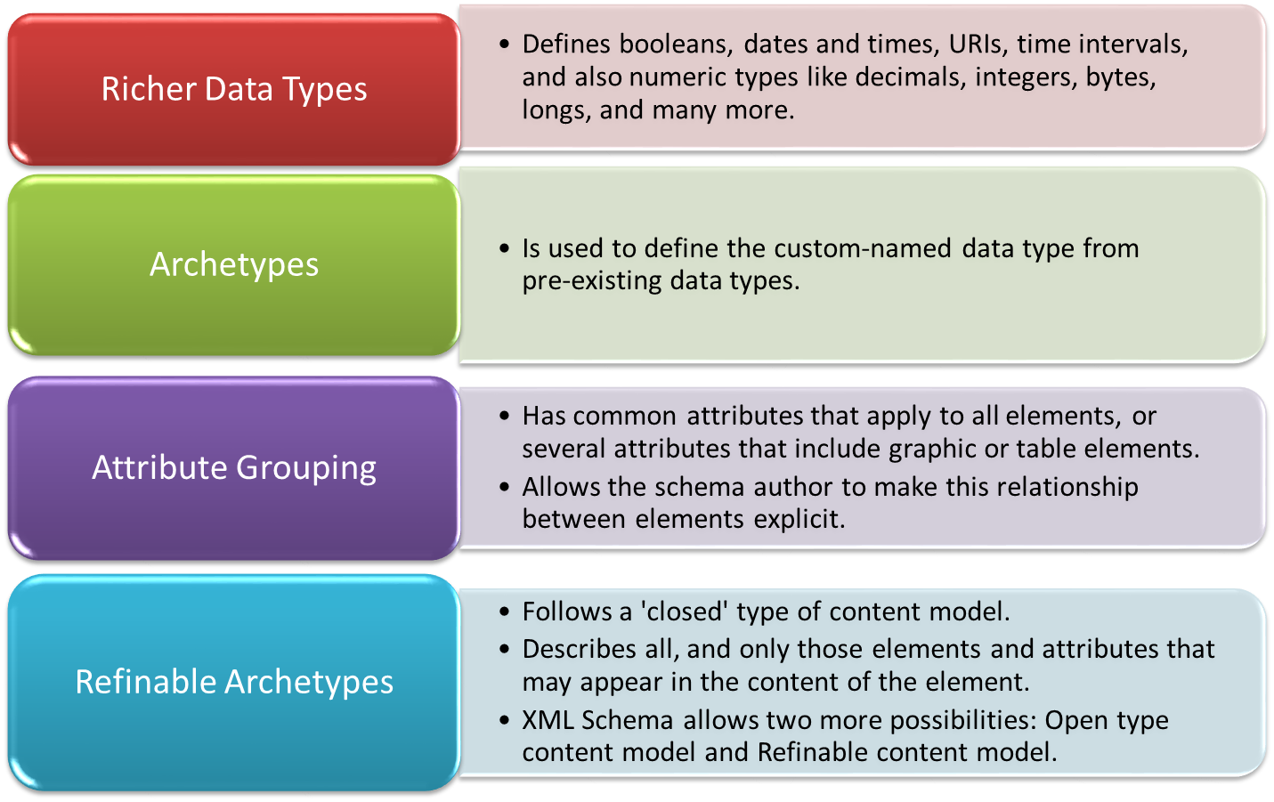
Additional Features of Schema

Slide 12
Comparing DTDs with Schemas 1-6
DTDs are written in a non-XML syntax
DTDs are not extensible
DTDs are written in a non-XML syntax
DTDs do not use XML notation and therefore they are difficult to write and use.
DTDs are not extensible. For example, if there is an Address DTD to catalog friends, and one wants to add a new section to the code for official contacts, then the entire DTD has to be rewritten.
Namespaces can be used to introduce an element type into an XML document. However, a Namespace cannot be used to refer to an element or an entity declaration in the DTD. If a Namespace is used, then the DTD has to be modified to include any elements taken from the Namespace.

Slide 13
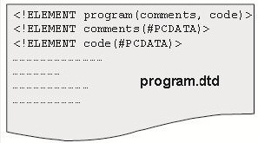
Comparing DTDs with Schemas 2-6
DTDS offer limited data typing
Figure shows a sample DTD.
DTDs can only express the data type of attributes in terms of explicit enumerations and a few coarse string formats. DTDs do not have a facility to describe numbers, dates, currency values, and so forth. Furthermore, DTDs do not have the ability to express the data type of character data in elements.

Slide 14
Comparing DTDs with Schemas 3-6
The code shows the sample external DTD file: program.dtd.
Sample XML File with a reference to dtd: program.xml.
Snippet
<!ELEMENT program (comments, code)>
<!ELEMENT comments (#PCDATA)>
<!ELEMENT code (#PCDATA)>
Snippet
<?xml version="1.0" encoding="ISO-8859-1"?>
<!DOCTYPE program SYSTEM "program.dtd">
<program>
<comments>
This is a simple Java Program. It will display the message
"Hello world!" on execution.
</comments>
<code>
public static void main(String[] args)
System.out.println("Hello World!"); // Display the string.
</code>
</program>

Slide 15
Comparing DTDs with Schemas 4-6
Simple XML document called "Book.xml“
The code demonstrates a simple XML document called "Book.xml”.
DTD File for Book.xml
The code demonstrates a DTD called “Book.dtd” that defines the elements of the Book.xml document.
Snippet
<?xml version="1.0"?>
<Book>
<Title> Million Seconds </Title>
<Author> Kelvin Brown </Author>
<Chapter> The plot of the story starts from here. </Chapter>
</Book>
Snippet
<!ELEMENT Book (Title, Author, Chapter)>
<!ELEMENT Title (#PCDATA)>
<!ELEMENT Author (#PCDATA)>
<!ELEMENT Chapter (#PCDATA)>

Slide 16
Comparing DTDs with Schemas 5-6
XML Schema for Book.xml
The code demonstrates that the corresponding XML Schema file called "Book.xsd".
Snippet
<?xml version="1.0"?>
<xs:schema xmlns:xs="http://www.w3.org/2001/XMLSchema" targetNamespace="http://www.booksworld.com" xmlns="http://www.booksworld.com" elementFormDefault="qualified">
<xs:element name="Book">
<xs:complexType>
<xs:sequence>
<xs:element name="Title" type="xs:string"/>
<xs:element name="Author" type="xs:string"/>
<xs:element name="Chapter" type="xs:string"/>
</xs:sequence>
</xs:complexType>
</xs:element>
</xs:schema>

Slide 17
Comparing DTDs with Schemas 6-6
Reference to Book.DTD in the instance document named Book.xml
The code demonstrates that a reference to "Book.dtd" document is placed inside in an XML document named Book.xml.
Reference to Book.DTD in the instance document named Book.xml
The code how schema and DTD are declared and referred in instance XML documents.
Snippet
<?xml version="1.0"?>
<!DOCTYPE note SYSTEM "http://www.booksworld.com/dtd/Book.dtd">
<Book>
<Title>Million Seconds</Title>
<Author>Kelvin Brown</Author>
<Chapter>The plot of the story starts from here.</Chapter>
</Book>
Snippet
<?xml version="1.0"?>
<Book xmlns="http://www.booksworld.com" xmlns:xsi="http://www.w3.org/2001/XMLSchema-instance" xsi:schemaLocation="http://www.booksworld.com Book.xsd">
<Title>Million Seconds</Title>
<Author>Kelvin Brown</Author>
<Chapter>The plot of the story starts from here.</Chapter>
</Book>

Slide 18
Advantages of XML Schemas over DTD 1-3
Richer data types
Archtypes
Attribute grouping
Refinable archetypes
Defines booleans, numbers, dates and times, URIs, integers, decimal numbers, real numbers, and also time intervals.
Allows to define own named data type from pre-existing data types.
For example, one can define a 'ContactList' data type, and then define two elements, ‘FriendsList’ and 'OfficialList' under that type.
Has common attributes that apply to all elements, or several attributes that include graphic or table elements.
Follows a 'closed' type of model. Describes all, and only those elements and attributes that may appear in the content of the element. Allows two more possibilities: 'open' and 'refinable'.

Slide 19
Advantages of XML Schemas over DTD 2-3
Sample schema File: mail.xsd
The code demonstrates a sample schema File: mail.xsd.
Snippet
<?xml version="1.0"?>
<xs:schema xmlns:xs="http://www.w3.org/2001/XMLSchema"
targetNamespace="http://www.abc.com"
xmlns="http://www.abc.com"
elementFormDefault="qualified">
<xs:element name="mail">
<xs:complexType>
<xs:sequence>
<xs:element name="to" type="xs:string"/>
<xs:element name="from" type="xs:string"/>
<xs:element name="header" type="xs:string"/>
<xs:element name="body" type="xs:string"/>
</xs:sequence>
</xs:complexType>
</xs:element>
</xs:schema>

Slide 20
Advantages of XML Schemas over DTD 3-3
The code demonstrates a sample XML File with a reference to schema: mail.xml.
Snippet
<?xml version="1.0"?>
<mail
xmlns="http://www.abc.com"
xmlns:xsi="http://www.w3.org/2001/XMLSchema-instance"
xsi:schemaLocation="http://www.abc.com mail.xsd">
<to>John</to>
<from>Jordan</from>
<header>Scheduler</header>
<body>3rd March Monday, 7:30 PM: board meeting!</body>
</mail>

Slide 21
Exploring XML Schemas
In this second lesson, Exploring XML Schemas, you will learn to:
  List the data types supported by schemas.
  Explain the XML Schema vocabulary.

Slide 22
Data Types Supported by Schema 1-7
Defines two sorts of data types, these are:
  Built-in data types
    Is available to all XML Schema authors.
    Is implemented by a conforming processor.
  User-derived data types
    Is defined in individual schema instances.
    Is particular to that schema.

Slide 23
Data Types Supported by Schema 2-7
Built-in data types specified are:
  String
    Group of characters.
    Data type can contain characters, line feeds, carriage returns, and tab characters.
    Consists of a combination of Unicode characters.
    Unicode is a universal standard to describe all possible characters of all languages with a library of symbols with one unique number for each symbol.
  The string declaration in the Schema and the element is as follows:
Syntax
<xs:element name="element_name" type="xs:string"/>
Snippet
<xs:element name="Customer" type="xs:string"/>
Snippet
<Customer>John Smith</Customer>

Slide 24
Data Types Supported by Schema 3-7
boolean
  Is used to specify a mathematical representation.
  Legal values for boolean data type are true and false.
  True can be replaced by the numeric value 1.
  False can be replaced by the value 0.
  The boolean declaration in the Schema and the element is as follows:
Syntax
<xs:attribute name="attribute_name" type="xs:boolean"/>
Snippet
<xs:attribute name="Disabled" type="xs:boolean"/>
Snippet
<Status Disabled="true">OFF</Status>

Slide 25
Data Types Supported by Schema 4-7
numeric
  Represents a numerical value.
  Includes numbers such as whole numbers and real numbers.
  The numeric declaration in the schema and the element is as follows:
Syntax
<xs:element name="element_name" type="xs:numeric"/>
Snippet
<xs:element name="Price" type="xs:numeric"/>
Snippet
<Price>500</Price>

Slide 26
Data Types Supported by Schema 5-7
dateTime
  Represents a particular time on a given date, written as a string.
  For example, "2001-05-10T12:35:40" can be considered as a dateTime string. The date is specified in the following form "YYYY-MM-DDThh:mm:ss":
  where,
    YYYY indicates the year,
    MM indicates the month,
    DD indicates the day,
    T indicates the start of the required time,
    hh indicates the hours,
    mm indicates the minutes,
    ss indicates the seconds.
Syntax
<xs:element name="element_name" type="xs:dateTime"/>

Slide 27
Data Types Supported by Schema 6-7
The datetime declaration in the schema and the element is as follows:
binary
  Include graphic files, executable programs, or any other string of binary data.
  Used to express binary-formatted data of two types such as base64Binary (Base64-encoded binary data) and hexBinary (hexadecimal-encoded binary data).
Snippet
<xs:element name="BeginAt" type="xs:dateTime"/>
Snippet
<start>2001-05-10T12:35:40</start>
Syntax
<xs:element name="image_name" type="xs:hexBinary"/>

Slide 28
Data Types Supported by Schema 7-7
The binary declaration in the schema is as follows:
anyURI
  A Universal Resource Identifier (URI) represents a file name or location of the file.
  The anyURI declaration in the schema is:
Snippet
<xs:element name="Logo" type="xs:hexBinary"/>
Syntax
<xs:attribute name="image_name" type="xs:anyURI"/>
Snippet
<xs:attribute name="flower" type="xs:anyURI"/>
An element in the xml document will be:
Snippet
<image flower="http://www.creativepictures.com/gallery/flower.gif" />

Slide 29
Additional Data Types 1-3
Are derived from the basic built-in data types are called base type data types.
The generated or derived data types, supported by the XML schema include:
Integer
  Is a base type for integer is the numeric data type.
  Includes both positive and negative numbers.
  For example, the numbers -2, -1, 0, 1, 2 are integers.
  Is used to specify a numeric value without a fractional component.
  The integer declaration in the schema and the element in the XML document is as follows:
Syntax
<xs:element name="element_name" type="xs:integer"/>
Snippet
<xs:element name="Age" type="xs:integer"/>
Snippet
<Age>999</Age>

Slide 30
Additional Data Types 2-3
Decimal
  Represents exact fractional parts such as 3.26.
  Is basetype for decimal is the number data type.
  Is the decimal data type is used to specify a numeric value.
  The decimal declaration in the schema and the element in the XML document is as follows:
Syntax
<xs:element name="element_name" type="xs:decimal"/>
Snippet
<xs:element name="Weight" type="xs:decimal"/>
Snippet
<prize>+70.7860</prize>

Slide 31
Additional Data Types 3-3
Time
  Is the base type data type.
  default representation is 16:35:26.
  Is used to specify a time.
  Is specified in the following form "hh:mm:ss" where, hh stands for hour, mm indicates the minute, and ss indicates the second.
  The time declaration in the schema and the element in the XML document is as follows:
Syntax
<xs:element name="element_name" type="xs:time"/>
Snippet
<xs:element name="BeginAt" type="xs:time"/>
Snippet
<BeginAt>09:30:10.5</BeginAt>

Slide 32
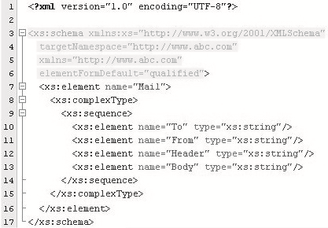
Schema Vocabulary 1-3
Is like creating any other XML document using a specialized vocabulary.
Figure depicts schema declaration.

Slide 33
Schema Vocabulary 2-3
Explanation for highlighted areas in the image:
xs:schema xmlns:xs=http://www.w3.org/2001/XMLSchema
  Every XML Schema starts with the root element <schema>. The code indicates that that the elements and data types used in the schema are derived from the "http://www.w3.org/2001/XMLSchema" namespace and prefixed with xs.
targetNamespace=http://www.abc.com
  It specifies that the elements defined in an XML document that refers this schema, come from the "http://www.abc.com" namespace.
  xmlns=http://www.abc.com
  This line of code points to "http://www.abc.com" as the default namespace.
elementFormDefault="qualified"
  It indicates that elements used by the XML instance document which were declared in this schema needs to be qualified by the namespace.

Slide 34
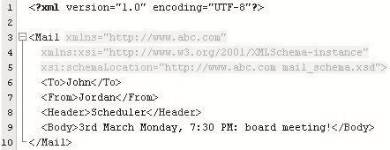
Schema Vocabulary 3-3
Figure illustrates using of schema declaration.
Explanation for highlighted areas in the image:
xmlns="http://www.abc.com"
It indicates the default namespace declaration. This declaration informs the schema-validator that all the elements used in this XML document are declared in the default ("http://www.abc.com") namespace.
xmlns:xsi="http://www.w3.org/2001/XMLSchema-instance"
This is the instance namespace available for the XML schema.
xsi:schemaLocation="http://www.abc.com mail.xsd">
This schemaLocation attribute has two values. The first value identifies the namespace. The second value is the location of the XML schema where it is stored.

Slide 35
Working with Complex Types
In this third lesson, Working with Complex Types, you will learn to:
  Describe complex type elements.
  Describe minOccurs and maxOccurs.
  Explain element content and mixed content.
  Describe how grouping can be done.

Slide 36
Complex Types 1-4
A schema assigns a type to each element and attribute that it declares.
Elements with complex type may contain nested elements and have attributes.
Only elements can contain complex types.
Complex type elements have four variations.
Empty elements
  Specifies attributes types, but do not permit content as shown in the following example.
Snippet
<xs:element name="Books">
<xs:complexType>
<xs:attributename="BookCode"
type="xs:positiveInteger"/>
</xs:complexType>
</xs:element>

Slide 37
Complex Types 2-4
Only Elements
  Contains elements and do not contain attributes as shown in the following example.
Snippet
<xs:element name="Books">
<xs:complexType>
<xs:sequence>
<xs:element name="ISBN" type="xs:string"/>
<xs:element name="Price" type="xs:string"/>
</xs:sequence>
</xs:complexType>
</xs:element>

Slide 38
Complex Types 3-4
Only Text
  Contains text and optionally may or may not have attributes as shown in the following example.
Snippet
<xs:complexType name="Books">
<xs:simpleContent>
<xs:extension base="xs:string">
<xs:attribute name="BookCode" type="xs: positiveInteger"/>
</xs:extension>
</xs:simpleContent>
</xs:complexType>

Slide 39
Complex Types 4-4
Mixed
  Contains text content as well as sub-elements within the element as shown in the following example. They may or may not have attributes.
Snippet
<xs:element name="Books">
<xs:complexType mixed="true">
<xs:sequence>
<xs:element name="BookName" type="xs:string"/>
<xs:element name="ISBN" type="xs:positiveInteger"/>
<xs:element name="Price" type="xs:string"/>
</xs:sequence>
</xs:complexType>
</xs:element>

Slide 40
Defining Complex Types 1-2
A complex element can be defined in two different ways. The following codes define the properties of complex element.
  By directly naming the element
Snippet
<xs:element name="Student">
<xs:complexType>
<xs:sequence>
<xs:element name="FirstName" type="xs:string"/>
<xs:element name="MiddleName" type="xs:string"/>
<xs:element name="LastName" type="xs:string"/>
</xs:sequence>
</xs:complexType>
</xs:element>
Student element can be declared by directly mentioning it in the schema.
Complex type mentions that the XML document contains nested XML elements.
Sequence element indicates that the child elements FirstName, MiddleName, and LastName appear in the same order as they are declared.

Slide 41
Defining Complex Types 2-2
  By using the name and type attribute of the complex type
Snippet
<xs:element name="Student" type="PersonInfo"/>
<xs:complexType name="personinfo">
<xs:sequence>
<xs:element name="FirstName" type="xs:string"/>
<xs:element name="LastName" type="xs:string"/>
</xs:sequence>
</xs:complexType>
The Student element can have a type such as PersonInfo that refers to the name of the complex type.
Several elements can reuse this complex type by referring to the name PersonInfo in their complex type declarations.

Slide 42
minOccurs and maxOccurs 1-2
Uses the markers *, ?, and + in DTD to indicate the number of times a particular child element could be used as content for an element.
Allows specifying a minimum and maximum number of times an element can occur.
Has both elements and attributes that use the following attributes:
  minOccurs
    Specifies the minimum number of occurrences of the element in an XML document.
    Has the default value for the minOccurs attribute is 1.
    Has a minOccurs value of 0, it is optional.
    An attribute is optional, if the minOccurs is 0. If minOccurs is set to 1, the attribute is required.
  maxOccurs
    Specifies the maximum number of occurrences of the element in an XML document.
    Has the default value for the maxOccurs attribute is 1.
    Elements can appear unlimited number of times.
    Attribute defaults to 1 unless it is specified.

Slide 43
minOccurs and maxOccurs 2-2
The code demonstrates the use of minOccurs and maxOccurs attributes.
Snippet
<xs:element name= "Books">
<xs:complexType>
<xs:sequence>
<xs:element name="ISBN" type="xs:string"/>
<xs:element name="Quantity" type="xs:string"
maxOccurs="100" minOccurs="0"/>
</xs:sequence>
</xs:complexType>
</xs:element>
The example demonstrates that the Quantity element can occur a minimum of zero times and a maximum of hundred times in the Books element.

Slide 44
Evolution of XML
The relationship between the minOccurs and maxOccurs attributes is displayed in the table.
minOccur | MaxOccur | Number of times an element can occur
0 | 1 | 0 or 1
1 | 1 | 1
0 | * | Infinite
1 | * | Atleast once
>0 | * | At least minOccurs times
>maxOccurs | >0 | 0
Any value | <minOccurs | 0

Slide 45
Element Content 1-2
Is a complex type can mention element content.
Contain only elements.
Has instances wherein the contained elements can also have child elements.
The code demonstrates the properties of element content.
Snippet
<?xml version="1.0"?>
<Books xmlns:xsi="http://www.w3.org/2001/XMLSchema-instance"
xsi:noNamespaceSchemaLocation= "Books.xsd">
<Title>A cup of tea</Title>
<Author>
<Name>Dennis Compton</Name>
</Author>
<Author>
<Name>George Ford</Name>
</Author>
<Publisher>
<Name>Orange</Name>
</Publisher>
</Books>

Slide 46
Element Content 2-2
This is an XML schema constrained document depicting book details.
Snippet
<?xml version="1.0"?>
<xs:schema xmlns:xsd="http://www.w3.org/2001/XMLSchema">
<xs:element name= "Books" type= "BookType">
<xs:complexType name= "AuthorType">
<xs:sequence>
<xs:element name= "Name" type="xs:string"/>
</xs:sequence>
</xs:complexType>
<xs:complexType name= "PublisherType">
<xs:sequence>
<xs:element name= "Name" type= "xs:string"/>
</xs:sequence>
</xs:complexType>
<xs:complexType name= "BookType">
<xs:sequence>
<xs:element name= "Title" type= "xs:string"/>
<xs:element name= "Author" type="ComposerType"
maxOccurs= "unbounded"/>
<xs:element name= "Publisher" type="PublisherType"
minOccurs="0" maxOccurs= "unbounded"/>

Slide 47
Mixed Content 1-2
Is complex type.
Contains text mixed with elements.
Is the order and the number of elements that appears in the mixed content can also be specified in the schema.
Is content type may or may not have attributes.
Is declared in exactly the same way, the declaration of element content is done.
It takes a mixed attribute set to the true value.

Slide 48
Mixed Content 2-2
The code demonstrates the properties of mixed content.
  Book.xml
  Book.xsd
Snippet
<Books>
Apocalypse written by<Author>Mary Jane</Author>
is of Genre<Category>Fiction</Type>.
</Books>
Snippet
<xs:element name="Books">
<xs:complexType mixed="true">
<xs:sequence>
<xs:element name="Author" type="xs:string"/>
<xs:element name="Category" type="xs:string"/>
</xs:sequence>
</xs:complexType>
</xs:element>

Slide 49
Grouping Constructs 1-3
XML Schema Language provides three grouping constructs that specify whether and how ordering of individual elements is important:
  xs:all
    Requires that each element in the group must occur at most once, but that order is not important.
    minOccurs attribute can be 0 or 1 and the maxOccurs attribute has to be 1. The code demonstrates this concept.
Snippet
<xs:element name= "Books">
<xs:complexType>
<xs:all>
<xs:element name="Name" type="xs:string" minOccurs= "1" maxOccurs= "1"/>
<xs:element name="ISBN" type="xs:string" minOccurs= "1" maxOccurs= "1"/>
<xs:element name="items" type="Items" minOccurs= "1" />
</xs:all>
</xs:complexType>
</xs:element>

Slide 50
Grouping Constructs 2-3
  xs:choice
    Is the opposite of all elements.
    Allows only one of the choices to appear.
    Provides an XML representation for describing a selection from a set of element types.
    Has minOccurs and maxOccurs attributes that establish exactly how many selections may be made from the choice.
    The code demonstrates this concept.
    Child elements that are mutually exclusive.
    Has a child element of the parent element AddressInfo.
Snippet
<xs:complexType name="AddressInfo">
<xs:group>
<xs:choice>
<xs:element name="Address" type="USAddress" />
<xs:element name="Address" type="UKAddress" />
<xs:element name="Address" type="FranceAddress" />
</xs:choice>
</xs:group>

Slide 51
Grouping Constructs 3-3
  xs:sequence
    Specifies each member of the sequence to appear in the same order in the instance document as mentioned in the xs:sequence element.
    Allows the element to appear can be controlled by the element's minOccurs and maxOccurs attributes.
    The code demonstrates this concept.
Snippet
<xs:element name="Books">
<xs:complexType>
<xs:sequence>
<xs:element name="Name" type="xs:string" />
<xs:element name="ISBN" type=" xs:string " />
<xs:element name="Price" type=" xs:string " />
</xs:sequence>
</xs:complexType>
</xs:element>

Slide 52
Working with Simple Types
In this last lesson, Working with Simple Types, you will learn to:
  Describe simple types.
  List and describe the data types used with simple types.
  Explain restrictions and facets.
  Identify the usage of attributes.

Slide 53
Defining a Simple Type Element 1-2
Is an XML element or attribute.
Contains only text and no other elements or attributes.
Specifies the type of data allowed within attributes and elements.
  'XXXX' is the name of the element.
  'YYYY' is the data type of the element.
Syntax
<xs:element name="XXXX" type="YYYY"/>

Slide 54
Defining a Simple Type Element 2-2
Book.xml: XML Elements
Book.xsd: Corresponding Simple Element Definitions
Snippet
<Book_name>The Da vinci code</Book_name>
<TotalNoOfPages>360</TotalNoOfPages>
<Author_name>Dan Brown</Author_name>
<xs:element name="Book_name" type="xs:string" />
<xs:element name="TotalNoOfPages" type="xs:integer"/>
<xs:element name="Author_name" type="xs:string"/>
Snippet
54

Slide 55
Data Types Used with Simple Types
Describes the content and the datatype of a document, rather than its structure.
Mentions the type of data an element.
Assigns it a particular simple type definition.
XML schema divides the elements of simple types into two broad categories:
  Built-in simple type
  User-defined simple type

Slide 56
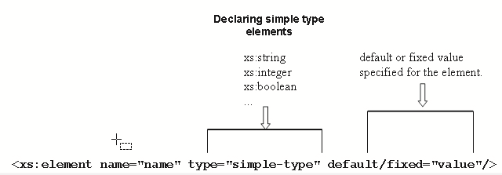
Built-in Simple Types 1-2
Has several built-in simple types, such as integer, date, float, and string that one can use without further modifications.
Contains a default value or a fixed value.
  A 'default' value is the value that is assigned automatically to the element when no other value has been specified.
  A 'fixed' value is assigned to an element, when there is no need to change the value for that element.
  Figure depicts the built-in simple types.

Slide 57
Built-in Simple Types 2-2
  XXXX is the name of the element.
  YYYY is the data type of the element.
  ZZZZ is the default value specified for the element.
The Code demonstrates the declaration of built-in simple type.
built-in simple type: element declaration
  Built-in simple types "AccountType" and "BalanceAmount".
  Has fixed value for the "AccountType" is "Savings" and has default value for "BalanceAmount" is "5000".
Syntax
<xs:element name="XXXX" type="YYYY"/>
Snippet
<xs:element name="AccountType" type="xs:string" fixed="Savings"/>
<xs:element name="BalanceAmount" type="xs:integer" default="5000"/>

Slide 58
User-defined Simple Types 1-3
Supports a library of built-in data types.
Implements the available restrictions to its content to accept non-negative numeric values.
Still accepts unwanted values like: <AngleMeasure>490</AngleMeasure>.
As per schema declaration, "490" is a valid non-negative numeric value, but still it needs numeric type that allows the values with a range from 0 to 360.
Hence, a custom user defined datatype can be created using the <simpleType> definition.
Syntax
<xs:simpleType name="name of the simpleType">
<xs:restriction base="built-in data type">
<xs:constraint="set constraint to limit the content"/>
</xsd:restriction>
</xsd:simpleType>

Slide 59
User-defined Simple Types 2-3
The codes demonstrate the properties of user-defined simple types.
Snippet
<xs:simpleType name="AngleMeasure">
<xs:restriction base="xs:integer">
<xs:minInclusive value="0"/>
<xs:maxInclusive value="360"/>
</xs:restriction>
</xs:simpleType>
This creates a new datatype called "AngleMeasure".
Elements of this type can hold integer values.
The value of "AngleMeasure" must be within the range of "0" to "360".

Slide 60
User-defined Simple Types 3-3
The codes demonstrate the properties of user-defined simple types.
Snippet
<xs:simpleType name="triangle">
<xs:restriction base="xsd:string">
<xs:enumeration value="isosceles"/>
<xs:enumeration value="right-angled"/>
<xs:enumeration value="equilateral"/>
</xs:restriction>
</xs:simpleType>
This creates a new datatype called "triangle".
Elements of this type can hold elements of triangle type.
Elements of this type can have either the value "isosceles", or "right-angled", or "equilateral".

Slide 61
Restrictions 1-2
If an XML element is of type "xs:integer" and contains a string like "Welcome", the element will not be validated.
Defines allowable values for XML elements and attributes.
Is specified for the simpleType elements and restriction types are declared using the <restriction> declaration.
Is used to declare a derived simpleType, which is a subset of its base simpleType.
The value of the base attribute can be any existing simpleType, or built-in XML Schema datatype.
Syntax
<restriction base="name of the simpleType you are deriving from">

Slide 62
Restrictions 2-2
Snippet
<xs:simpleType name="Age">
<xs:restriction base="xs:integer">
...
...
</xs:restriction>
</xs:simpleType>

Slide 63
Facets 1-3
Specifies custom restrictions on XML elements and attributes.
Restricts the set or range of values a datatype can contain.
Values range defined by the facet must be equal to or narrower than the value range of the base type.
Has 12 facet elements, declared using a common syntax.
Has a compulsory value attribute that indicates the value for the facet.
Restrictions can contain more than one facet.
Values appearing in the instance and value spaces must conform to all the listed facets.

Slide 64
Facets 2-3
The table depicts the constraining facets.
Facet | Description
minExclusive | Specifies the minimum value for the type that excludes the value provided.
minInclusive | Specifies the minimum value for the type that includes the value provided.
maxExclusive | Specifies the maximum value for the type that excludes the value provided.
maxExclusive | Specifies the maximum value for the type that includes the value provided.
totalDigits | Specifies the total number of digits in a numeric type.
fractionDigits | Specifies the number of fractional digits in a numeric type.
Length | Specifies the number of items in a list type or the number of characters in a string type.
minLength | Specifies the minimum number of items in a list type or the minimum number of characters in a string type.
maxLength | Specifies the maximum number of items in a list type or the maximum number of characters in a string type.
enumeration | Specifies an allowable value in an enumerated list.
whiteSpace | Specifies how whitespace should be treated within the type.
Pattern | Restricts string types.

Slide 65
Facets 3-3
Syntax
<xs:simpleType name= "name">
<xs:restriction base= "xs:source">
<xs:facet value= "value"/>
<xs:facet value= "value"/>
…
</xs:restriction>
</xs:simpleType>
The code demonstrates that the value attribute gives the value of that facet.
Snippet
<xs:simpleType name="triangle">
<xs:restriction base="xs:string">
<xs:enumeration value="isosceles"/>
<xs:enumeration value="right-angled"/>
<xs:enumeration value="equilateral"/>
</xs:restriction>
</xs:simpleType>

Slide 66
Attributes 1-5
Describe elements.
Declarations are similar to element declarations.
Uses an <xs:attribute> element.
Indicates whether it is required or optional or whether it has a default value.
Assigns a default value automatically when no other value is specified.
Specifies that the use attribute is required or optional.

Slide 67
Attributes 2-5
Different values that can be assigned to the attributes:
  Default
    Is automatically assigned to the attribute when no other value is specified.
    In this code, the default value of the attribute genre is fiction.
  Fixed
    This value makes the attribute fixed. A fixed value is automatically assigned to the attribute, and another value cannot be specified.
Snippet
<xs:attribute name="genre" type="xs:string" default="fiction"/>
Snippet
<xs:attribute name="genre" type="xs:string" fixed="fiction"/>

Slide 68
Attributes 3-5
  Optional
    Makes the attribute optional, which means that the attribute may have any value.
  Prohibited
    This value means that the attribute cannot be used.
  Required
    This value makes the attribute required. The attribute can have any value.
Snippet
xs:attribute name="genre" type="xs:string" use="optional"/>
Snippet
xs:attribute name="genre" type="xs:string" use="prohibited"/>
Snippet
xs:attribute name="genre" type="xs:string" use="required"/>

Slide 69
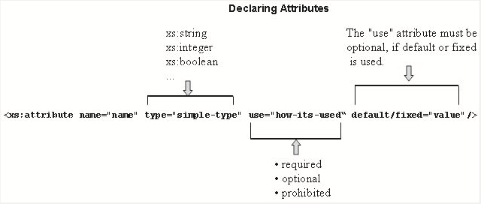
Attributes 4-5
Figure depicts the attribute declaration.
Syntax
<xs:attribute name="Attribute_name" type="Attribute_datatype"/>

Slide 70
Attributes 5-5
In the following example, xs:attribute elements comes after xs:sequence and xs:group that forms the body of the element.
Snippet
<xs:complexType name= "SingerType">
<xs:sequence>
<xs:element name= "Name">
<xs:complexType>
<xs:all>
<xs:element name= "FirstName" type="xs:string"/>
<xs:element name= "LastName" type="xs:string"/>
</xs:all>
</xs:complexType>
</xs:element>
</xs:sequence>
<xs:attribute name= "age" type="xs:positiveInteger" use= "optional/>
</xs:complexType>

Slide 71
Summary
In this module, XML Schema, you learnt about:
  XML Schema
    An XML Schema is an XML-based alternative to DTDs, which describes the structure of an XML document. The XML Schema language is also referred to as XML Schema Definition (XSD). An XML Schema can define elements, attributes, child elements and the possible values that can appear in a document. Schemas overcome the limitations of DTDs and allow Web applications to exchange XML data robustly, without relying on ad hoc validation tools.
  Exploring XML Schemas
    XML schema offers a range of data types. It supports built-in data types like string, boolean, number, dateTime, binary, and uri. Additional data types like integer, decimal, real, time, timeperiod, and user defined data types.
  Working with Complex Type
    Elements with complex type may contain nested elements and have attributes. A complex element can be defined by directly naming the element and by using the name and the type attribute of the complex type. minOccurs specifies the minimum number of occurrences of the element in an XML document. maxOccurs specifies the maximum number of occurrences of the element in an XML document. Element content in an XML document contains only XML elements and mixed content contains text mixed with elements. The grouping constructs in XML schema specify the order of XML elements.
  Working with Simple Types
    The elements of simple type describe the content and data type of the element rather than its structure. The simple type can have built-in and user defined data types. Simple type definition takes one of the two values, default or fixed as per the requirement. The user-defined data type can be derived from a built in type or an existing simple type. Use of restrictions and facets restricts its content to user prescribed values. Schema supports usage of attributes in elements, which is declared with a simple type definition.

